Slide 1
Object Tracking
Optical Flow
Lucas Kanade Method
Gunnar Farneback’s Algorithm

Slide 2
Introduction
We are going to demonstrate Object Tracking using Optical Flow. Optical Flow is the pattern of apparent motion (of objects within images) between two consecutive frames.
It assumes that the pixel intensities of an object do not change between frames and the neighbouring pixels have similar motion.
This can be used for tracking movement on a camera capture or video.

Slide 3
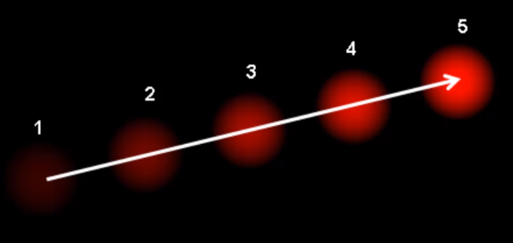
Object Tracking
In this image it is difficult to determine if the ball is moving up from the left to the right or if the camera is moving down to the left.

Slide 4
Lucas Kanade
The Lucas Kanade method is used on sparse feature sets. If we want to track movement from Frame 4 to Frame 5 then we pass in Frame 4, Points from Frame 4 and Frame 5.

Slide 5
Lucas Kanade
This makes an assumption that the pixel intensities of an object do not change between frames and the neighbouring pixels have similar motion.

Slide 6
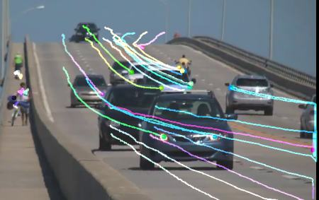
Lucas Kanade Method
Lucas-Kanade method takes a 3x3 grid patch around a designated point. So all the 9 points will have the same motion.
This method works well with small motions but it may lose tracking if larger motions are detected.
*Read more here.

Slide 7
Dense Optical Flow
OpenCV provides a function for dense optical flow. It is based on Gunner Farneback’s algorithm which is explained in “Two-Frame Motion Estimation Based on Polynomial Expansion” by Gunner Farneback in 2003.
This algorithm will help to find the magnitude and direction of movement. The results are colour coded to provide easier understanding when visualising. The direction corresponds to the Hue value of the image and Magnitude corresponds to the Value plane.

Slide 8
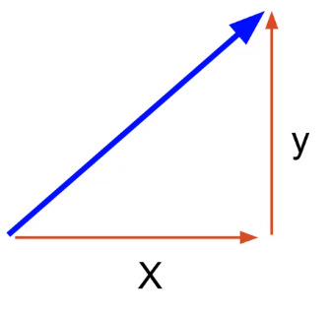
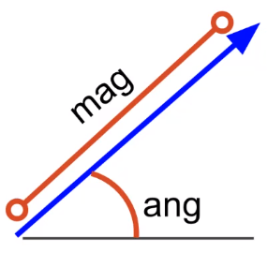
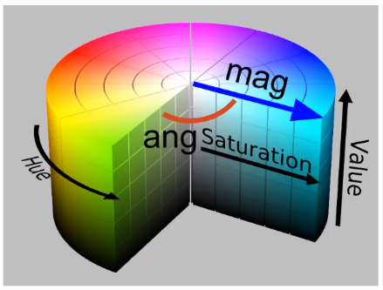
Dense Optical Flow
We have the vector flow information for the object. We want to convert this into polar coordinates to get magnitude and angle. We then map this on to a HSV colour chart to choose a hue/saturation. Using the cartToPolar function in OpenCV.

Slide 9
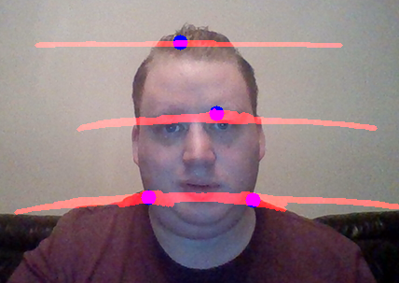
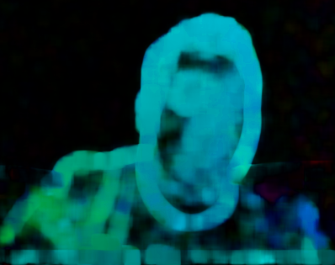
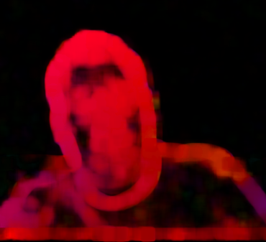
Optical Flow
Sparse
Dense

Slide 10
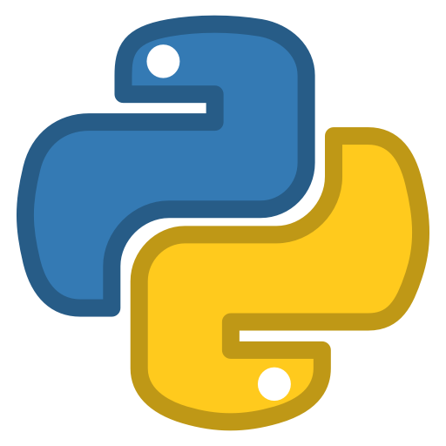

Practical Activities
The practical for today’s class (Week 4b) will explore:
Optical Flow
Lucas Kanade Method (Sparse)
Gunnar Farneback's algorithm (Dense)
Use both the Sparse Optical Flow and Dense Optical Flow with different backgrounds and lighting levels.
Move your head/hand left to right and up and down

